Slide 1

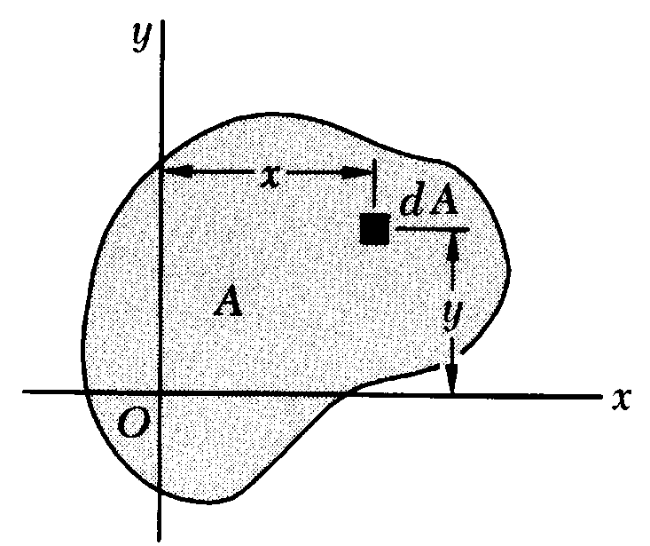
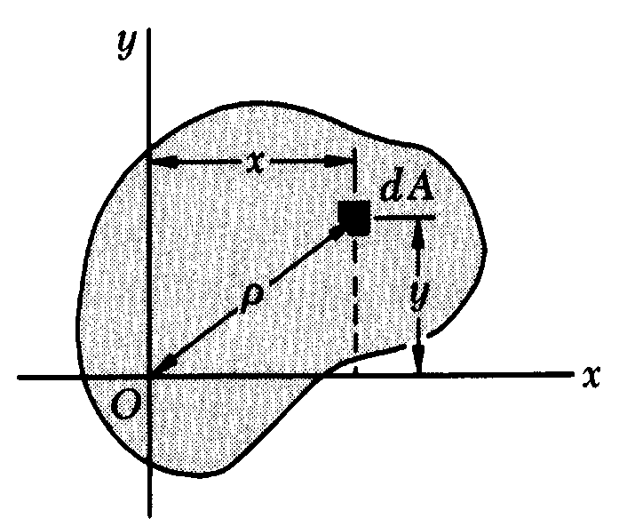
APPENDIX A
MOMENTS OF AREAS
A.3 Second Moment, or Moment of Inertia, of
An Area; Radius of Gyration
Moment of Inertia of A With Respect To the And x Axis And y Axis are Defined, Respectively, As
Define the Polar Moment of Inertia of the Area A With Respect To Point O As the Integral :

Slide 2
T-1
MOMENT OF INERTIA
Moment of Inertia:
The product of the elemental area and square of the perpendicular distance between the centroid of area and the axis of reference is the “Moment of Inertia” about the reference axis.
I_{xx} = ∫dA. y²
I_{yy} = ∫dA. x²
y
dA
x
y
x

Slide 3
T-2
It is also called second moment of area because first moment of elemental area is dA.y and dA.x; and if it is again multiplied by the distance,we get second moment of elemental area as (dA.y)y and (dA.x)x.

Slide 4
T-3
Polar moment of Inertia
(Perpendicular Axes theorem)
The moment of inertia of an area about an axis perpendicular to the plane of the area is called “Polar Moment of Inertia” and it is denoted by symbol I_{zz} or J or I_{p}. The moment of inertia of an area in xy plane w.r.to z. axis is I_{zz} = I_{p} = J = ∫r²dA = ∫(x² + y²) dA = ∫x²dA + ∫y²dA = I_{xx} +I_{yy}
Y
x
r
y
O
z
x

Slide 5
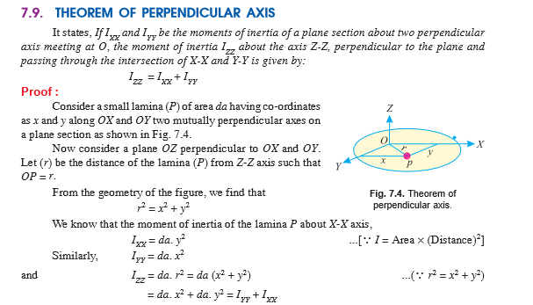

Slide 6
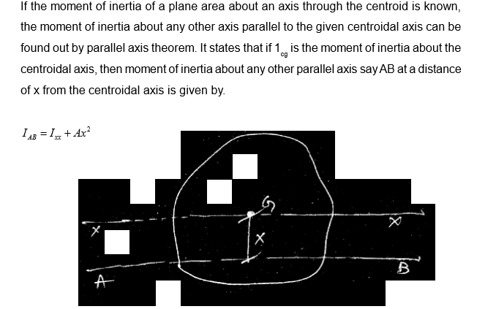

Slide 7

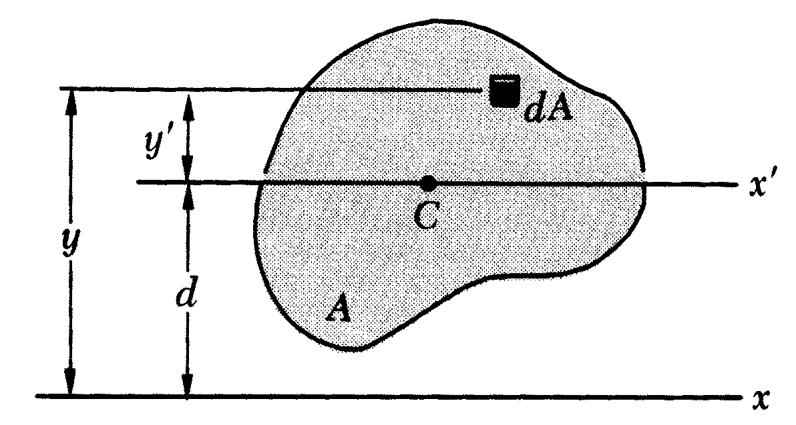
APPENDIX A
MOMENTS OF AREAS
A.4 Parallel-Axis Theorem

Slide 8
T-7
Hence, moment of inertia of any area about an axis xx is equal to the M.I. about parallel centroidal axis plus the product of the total area and square of the distance between the two axes.
Radius of Gyration
It is the perpendicular distance at which the whole area may be assumed to be concentrated, yielding the same second moment of the area above the axis under consideration.

Slide 9
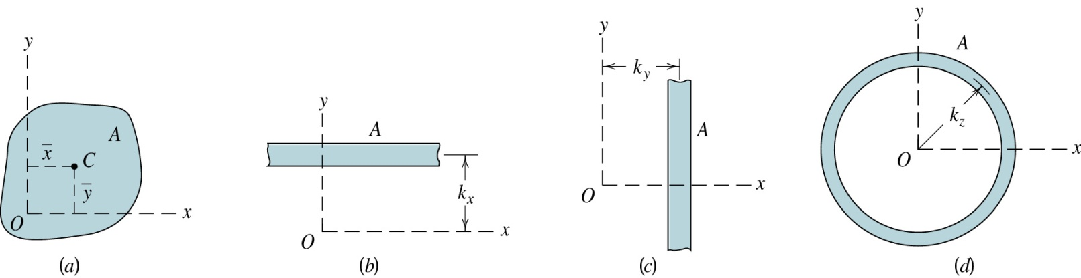
Radius of Gyration
For an area A with moment of inertia I_{x} and I_{y}
Visualize it as concentrated into a long narrow strip of area A a distance k_{x} from the x-axis. The moment of inertia about x-axis is I_{x}. Therefore,
The distance k_{x} = radius of gyration of the area about x-axis

Slide 10
Radius of Gyration
Similarly,
Do not confused with centroid C!

Slide 11
T-8
y
I_{yy} = A.r_{yy}²
I_{xx} = A.r_{xx}²
r_{yy} = √ I_{yy}/A
And r_{xx} = √ I_{xx} /A
A
A
r_{xx}
r_{yy}
y
x
x
r_{xx} and r_{yy} are called the radii of gyration

Slide 12
T-9
MOMENT OF INERTIA BY DIRECT INTEGRATION
M.I. about its horizontal centroidal axis :
RECTANGLE :
I_{XoXo} = _{-d/2} ∫ ^{+d/2} dAy²
=_{-d/2}∫^{+d/2} (b.dy)y²
= bd³/12
About its base
I_{XX}=I_{XoXo} +A(d)²
Where d = d/2, the distance between axes xx and x_{o}x_{o}
=bd³/12+(bd)(d/2)²
=bd³/12+bd³/4=bd³/3
.
dy
d/2
y
x₀
d
x₀
G
x
x
b

Slide 13
T-17
Sl.No | Figure | I _{x0-x0} | I _{y0-y0} | I _{xx} | I _{yy}
1 |  | bd³/12 | hb³/12 | bd³/3 | -
2 |  | bh³/36 | hb³/36 - | bh³/12 | -
3 |  | πd⁴/64 | πd⁴/64 | Iz=πd⁴/32 | -
4 |  | 0.11R⁴ | πd⁴/128 | πd⁴/128 | -
5 |  | 0.055R⁴ | 0.055R⁴ | πR⁴/16 | πR⁴/16
b
Y
d
x₀
x₀
d/2
x
x
Y
X_{o}
h
x₀
x₀
h/3
x
x
b
y₀
R
x₀
x₀
O
y₀
y₀
4R/3π
x₀
x₀
x
y₀
x
y
y₀
x₀
4R/3π
4R/3π

Slide 14

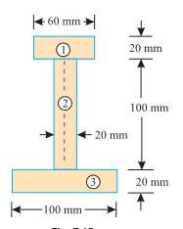

Slide 15
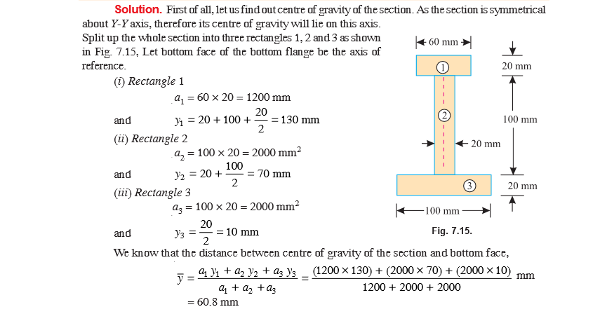

Slide 16
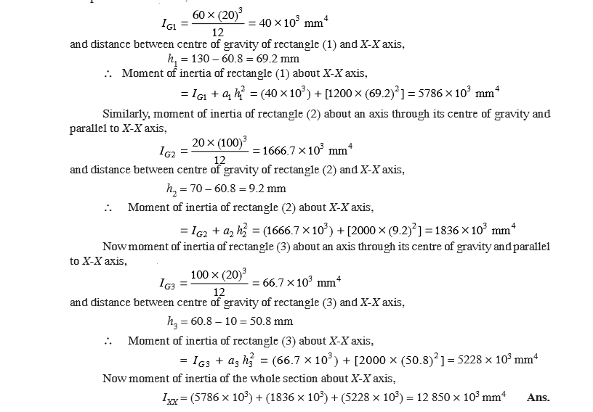

Slide 17
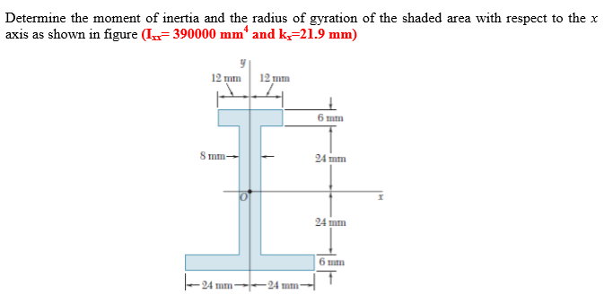

Slide 18
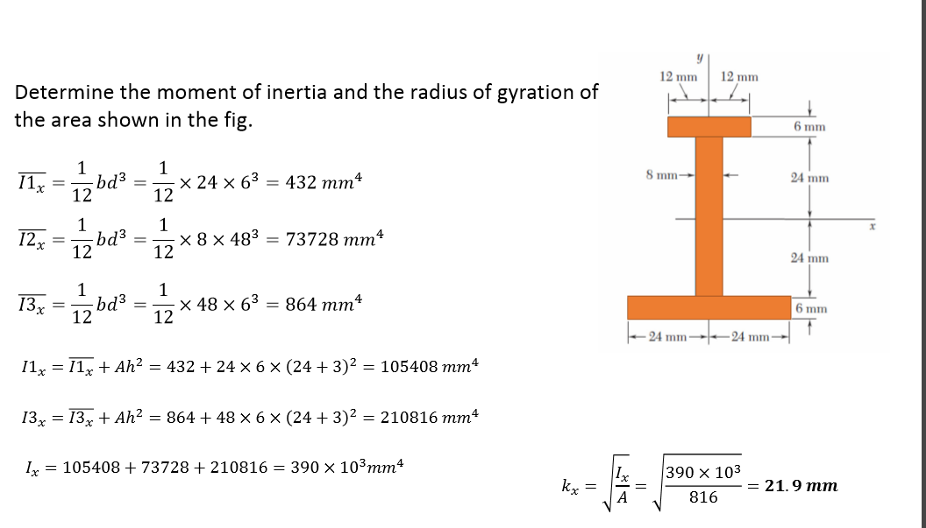

Slide 19
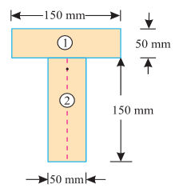

Slide 20
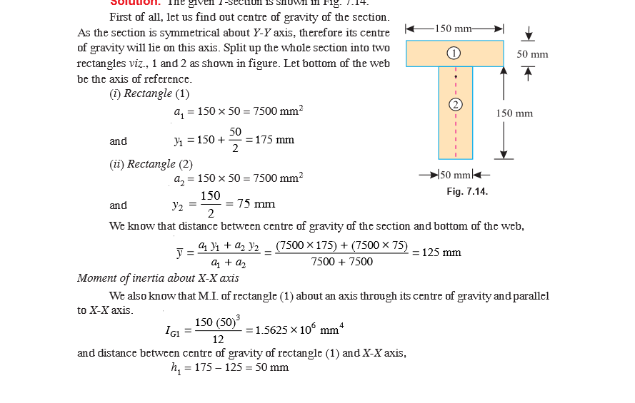

Slide 21
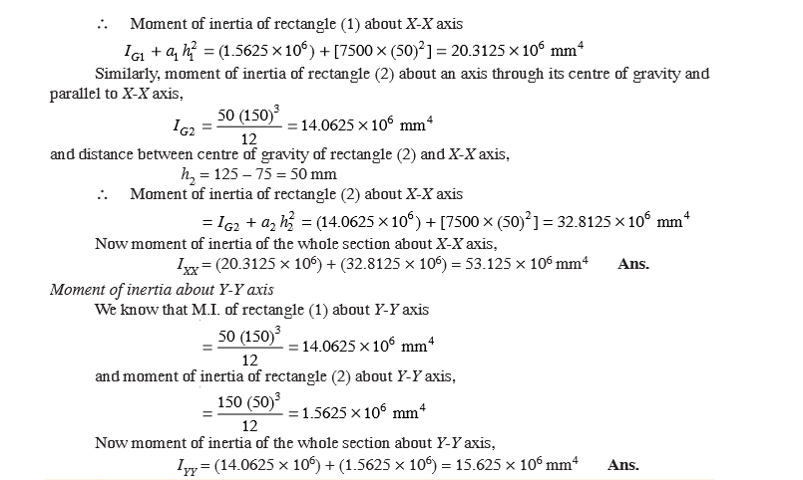

Slide 22
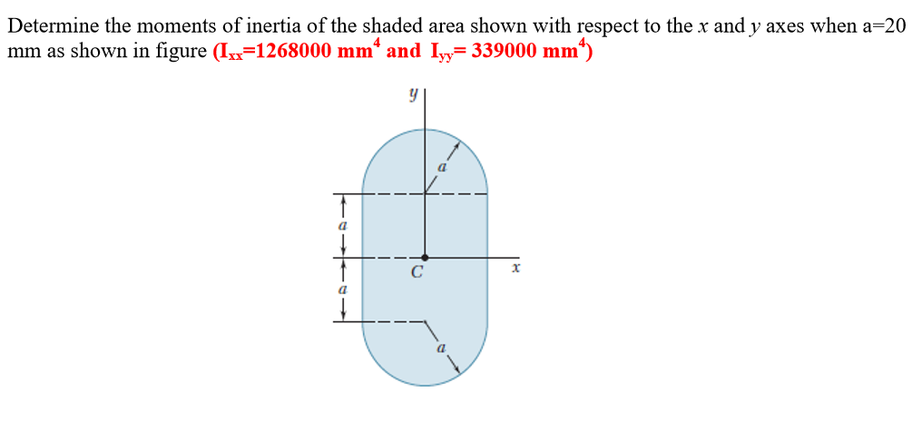
Semicircle Moment of inertia
Ix (about c.g) | Iy(about c.g)
0.11R⁴ | πR⁴/8

Slide 23
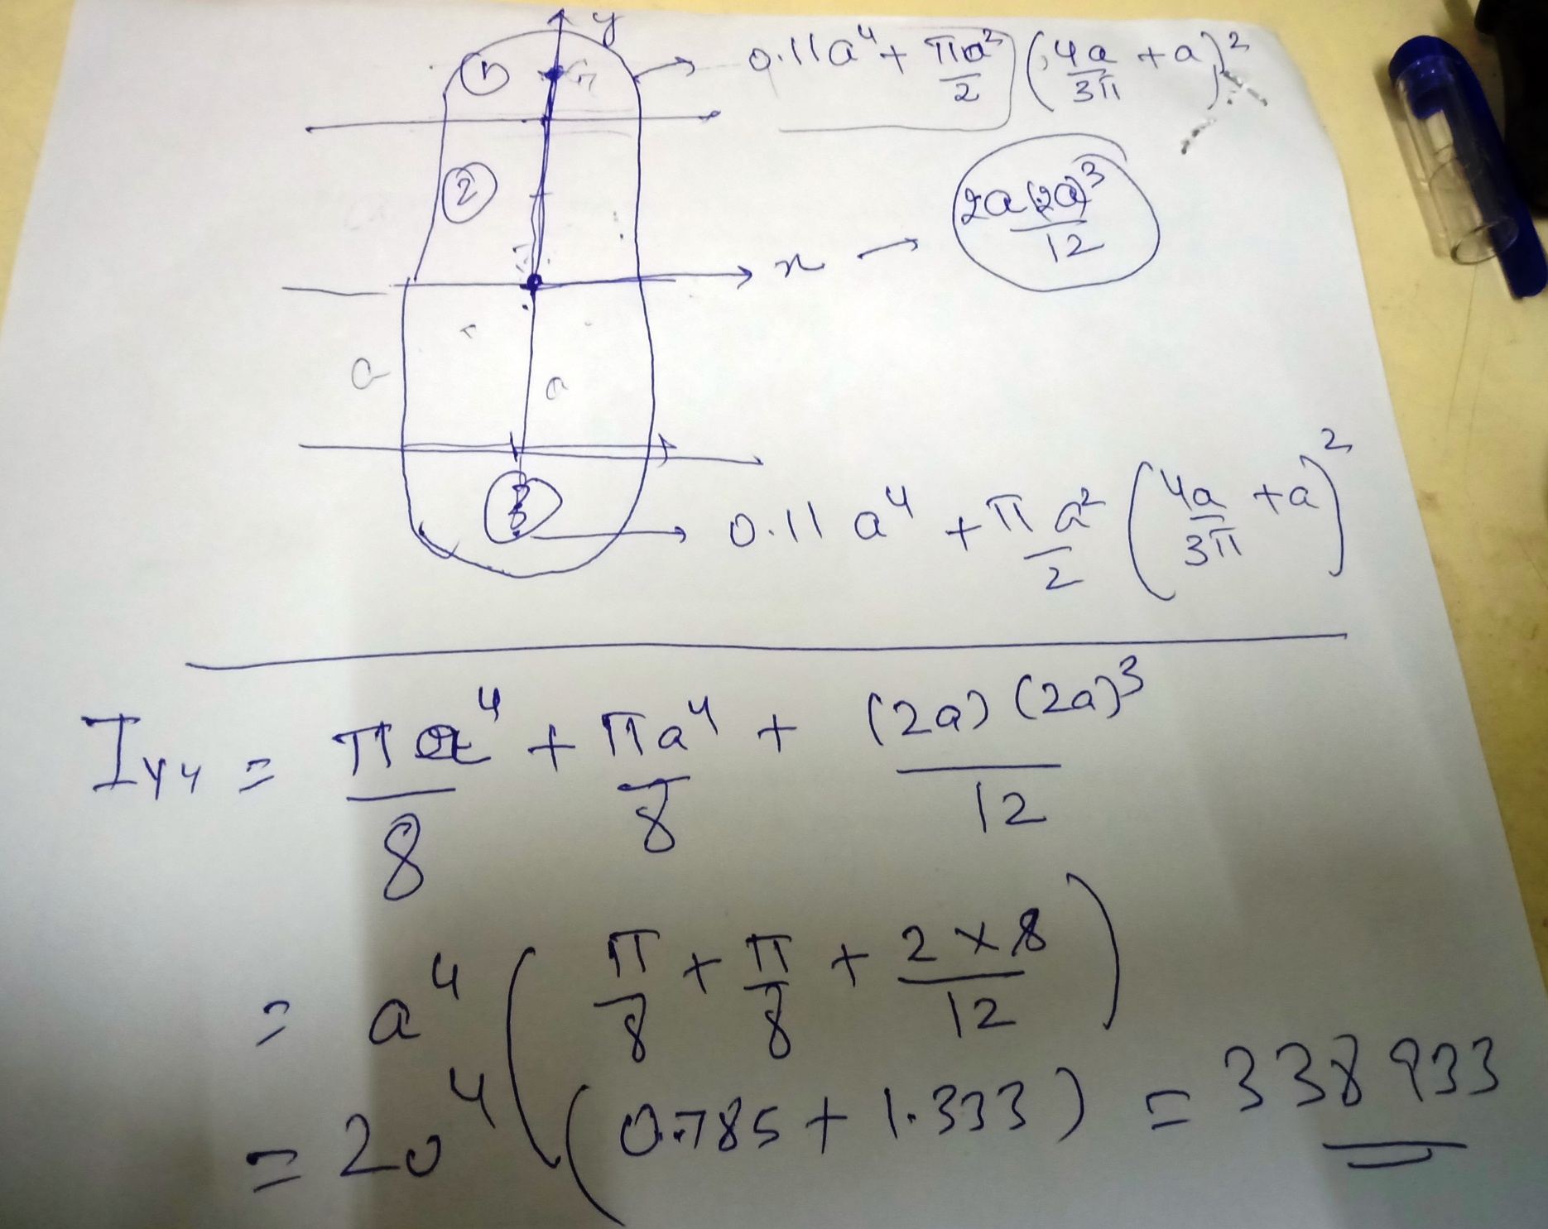

Slide 24
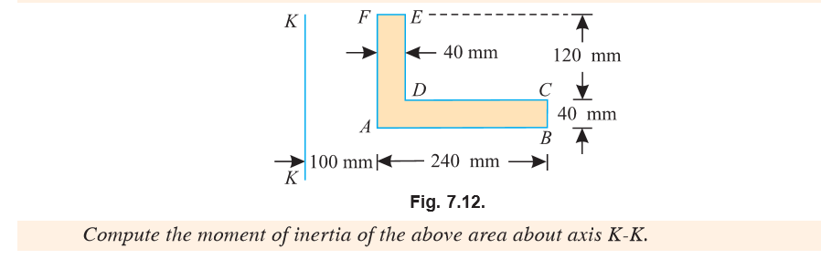

Slide 25
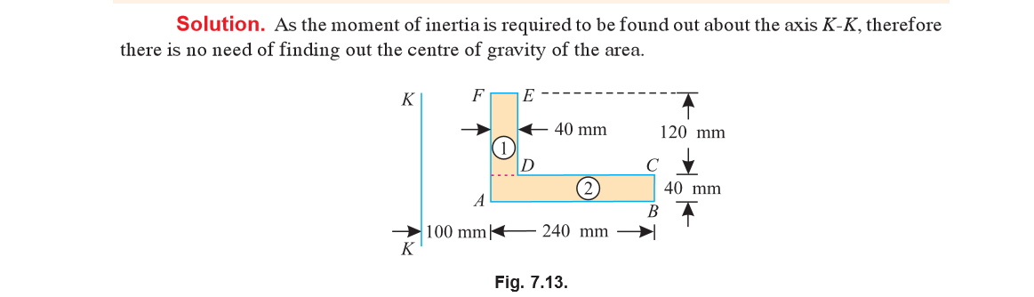

Slide 26
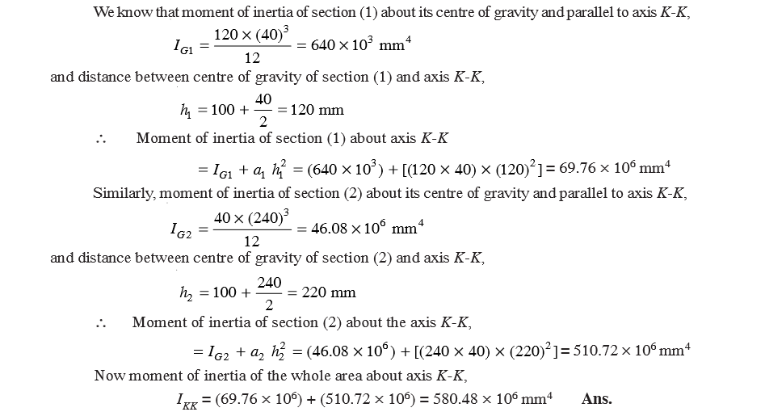

Slide 27
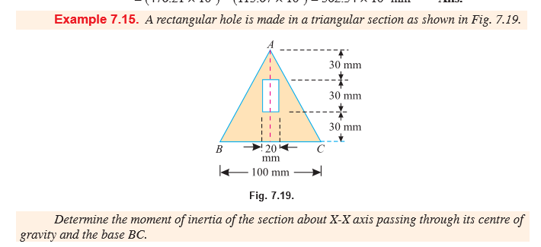

Slide 28
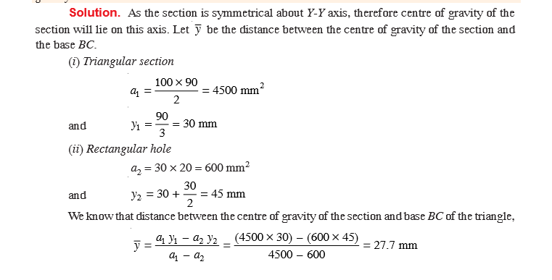

Slide 29
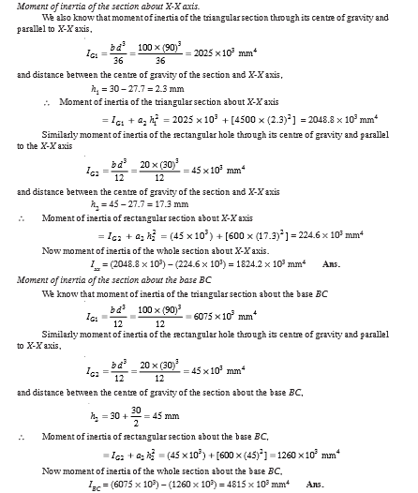

Slide 30
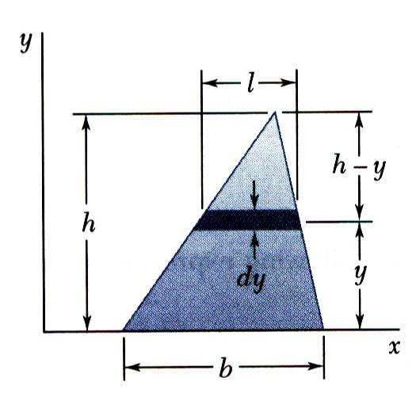
MOI Of triangle about base
SOLUTION:
A differential strip parallel to the x axis is chosen for dA.
For similar triangles,
Determine the moment of inertia of a triangle with respect to its base.
Integrating dI_{x} from y = 0 to y = h,

Slide 31
T-10
(b) Moment of inertia about its centroidal axis:
_
I_{xx} = I_{x0x0} + Ad²
_
I_{x0x0} = I_{xx} – Ad²
= bh³/12 – bh/2 . (h/3)² = bh³/36
(h-y)
h
dy
x
x₀
y
x₀
h/3
x
b

Slide 32
T-11
(b) Moment of inertia about its centroidal axis:
_
I_{xx} = I_{x0x0} + Ad²
_
I_{x0x0} = I_{xx} – Ad²
= bh³/12 – bh/2 . (h/3)² = bh³/36

Slide 33
T-12
3. CIRCULAR AREA:
I_{x0x0} =  dA . y²
_{R 2}
=   (r.d.dr) r²Sin²
⁰ ⁰
_{R 2}
=  r³.dr Sin² d
⁰ ⁰
_{R 2}
= r³ dr  {(1- Cos2)/2} d
⁰ _{R} ⁰ _{2}
=[r⁴/4] [/2 – Sin2/4]
0 0
= R⁴/4[ - 0] = R⁴/4
I_{XoXo} =  R⁴/4 = D⁴/64
d
r
y=rSin
x₀
❑
x₀
R
x
x
dA = r dr dθ

Slide 34
Moments of Basic Shapes
Rectangle
y
x
dA = r dr dθ
Circular
y
x

Slide 35
T-13
4. SEMI CIRCULAR AREA:
I_{xx} =  dA . y²
_{R }
=   (r.d.dr) r²Sin²
⁰_{R}⁰ 
= r³.dr  Sin² d
⁰ ⁰
_{R }
=  r³ dr (1- Cos2)/2) d
⁰ ⁰ 
=[R⁴/4] [/2 – Sin2/4]
⁰
= R⁴/4[/2 - 0] = R⁴/8
y₀
x₀
R
x₀
4R/3
x
x
y₀

Slide 36
T-14
About horizontal centroidal axis:
I_{xx} = I_{x0x0} + A(d)²
I_{x0x0} = I_{xx} – A(d)²
=  R⁴/8 R²/2 . (4R/3)²
I_{x0x0} = 0.11R⁴

Slide 37
T-15
QUARTER CIRCLE:
I_{xx} = I_{yy}
_{R /2}
I_{xx} =   (r.d.dr). r²Sin²
⁰ ⁰
_{R /2}
= r³.dr  Sin² d
⁰ ⁰
_{R /2}
= r3 dr  (1- Cos2)/2) d
⁰ ⁰ _{/2}
=[R⁴/4] [/2 – (Sin2 )/4]
⁰
= R⁴ (/16 – 0) = R⁴/16
y
y₀
x₀
x₀
4R/3π
x
x
y
y₀
4R/3π

Slide 38
T-16
Moment of inertia about Centroidal axis,
_
I_{x0x0} = I_{xx} - Ad²
= R⁴/16 - R². (0. 424R)²
= 0.055R⁴
The following table indicates the final values of M.I. about X and Y axes for different geometrical figures.

Slide 39
T-17
Sl.No | Figure | I _{x0-x0} | I _{y0-y0} | I _{xx} | I _{yy}
1 |  | bd³/12 | hb³/12 | bd³/3 | -
2 |  | bh³/36 | hb³/36 - | bh³/12 | -
3 |  | πd⁴/64 | πd⁴/64 | Iz=πd⁴/32 | -
4 |  | 0.11R⁴ | πd⁴/128 | πd⁴/128 | -
5 |  | 0.055R⁴ | 0.055R⁴ | πR⁴/16 | πR⁴/16
b
Y
d
x₀
x₀
d/2
x
x
Y
X_{o}
h
x₀
x₀
h/3
x
x
b
y₀
R
x₀
x₀
O
y₀
y₀
4R/3π
x₀
x₀
x
y₀
x
y
y₀
x₀
4R/3π
4R/3π

Slide 40
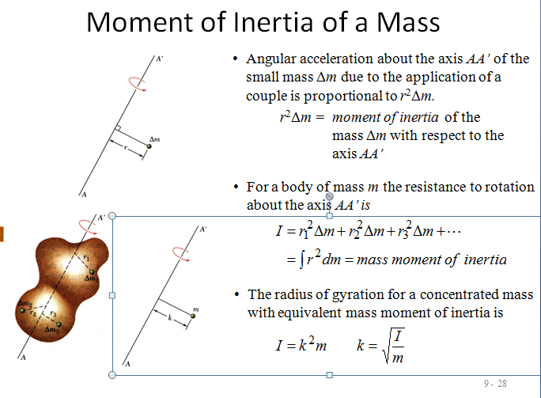

Slide 41
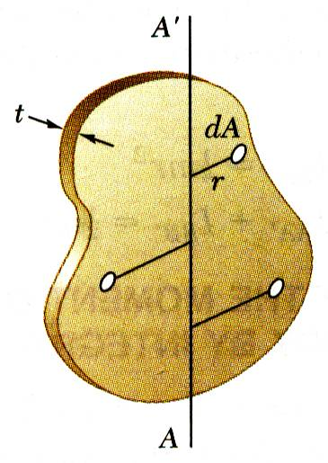
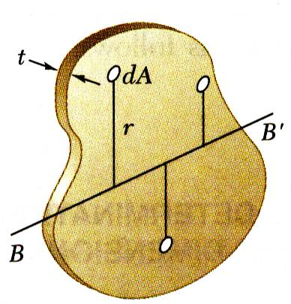
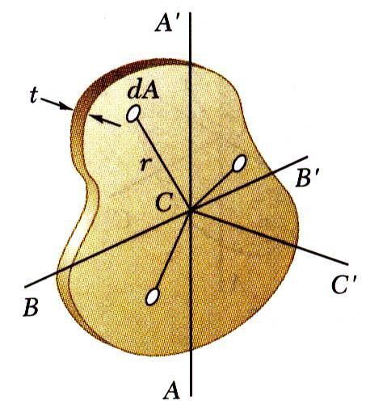
Moments of Inertia of Thin Plates
For a thin plate of uniform thickness t and homogeneous material of density ρ, the mass moment of inertia with respect to axis AA’ contained in the plate is
Similarly, for perpendicular axis BB’ which is also contained in the plate,
For the axis CC’ which is perpendicular to the plate,

Slide 42
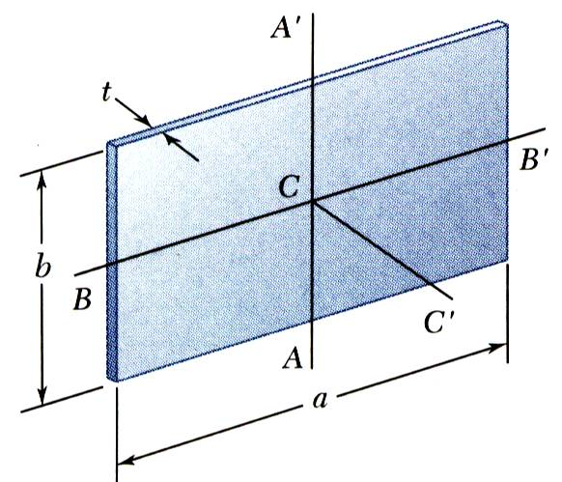
Moments of Inertia of Thin Plates
For the principal centroidal axes on a rectangular plate,

